Slide 1

SIG React 24-07-2018

Slide 2
History and features of React
Titel van de presentatie
<number>

Slide 3
Components
Components:
Are reusable blocks of code
Render JSX
Can be passed propperties when called
Have their own state
Titel van de presentatie
<number>

Slide 4

Components
Titel van de presentatie
<number>

Slide 5
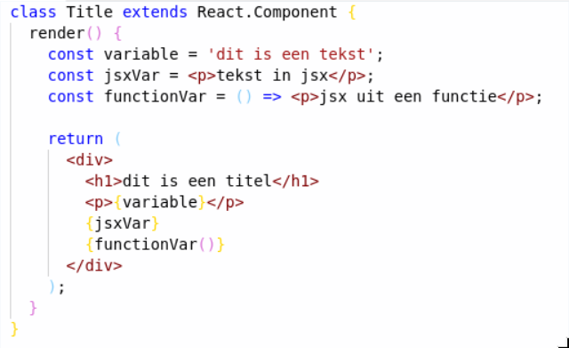

JSX
Titel van de presentatie
<number>

Slide 6
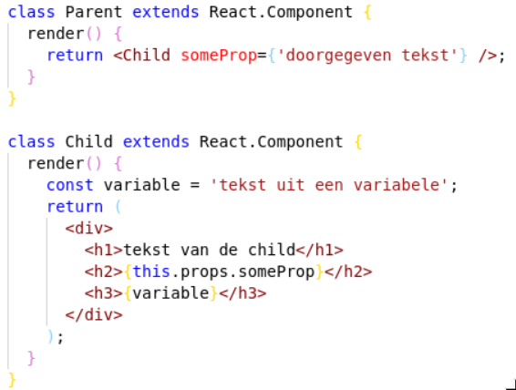

Props
Titel van de presentatie
<number>

Slide 7
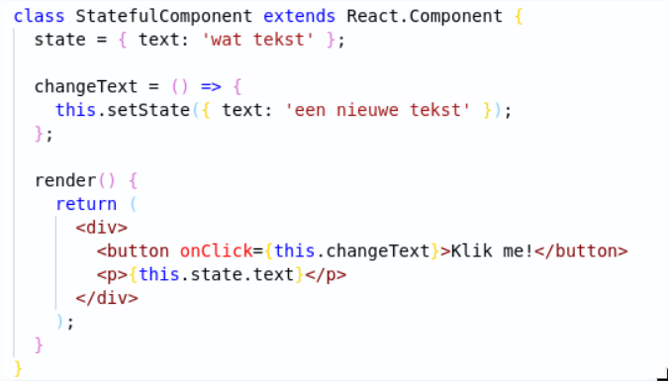


State
Titel van de presentatie
<number>

Slide 8

Hands on tijd!
Vragen?
Titel van de presentatie
<number>

Slide 9
Hands-on: Editing JSX
Git clone https://github.com/AMIS-Services/react-series
Cd into dir exercise and run yarn start
Inspect the page in your browser
Edit the JSX to show a AMISBnB as a title
Titel van de presentatie
<number>

Slide 10
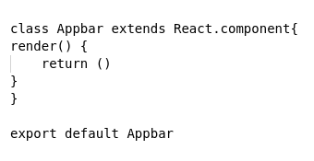
Hands-on: Creating a component
Create the folder src/components
Create a new component by adding a file with the code shown below
Add JSX to the render method. Add some styling in a .css file.
Import and use the component in the App.js
Titel van de presentatie
<number>

Slide 11
Hands-on: passing props to your component
Pass a prop to your Appbar
Use this prop in the Appbar (availabe with `this.props.propName`)
Try using multiple Appbar components in your App.js with different values for your prop
Titel van de presentatie
<number>

Slide 12
Hands-on: displaying data
Import the data from the resources folder (import { accomodations } from ‘src/resources/accommodations.js’)
Use accommodations.map(() => {}) to display a div with the accommodations name for each accommodation
Move the rendering of the accommodations to a separate function which returns JSX. Use `accommodations.map(this.renderAccomodations)`.
Display more data. Add some styling.
Titel van de presentatie
<number>

Slide 13
Hands-on: move accommodation to it’s own component
Create a new .js and .css file for accomodation. Create a new component and move the rendering of an accommodation to this component. Move the css.
Display the component <HomeIcon /> from the resources folder. Have its color be based on favorite being true or false.
Titel van de presentatie
<number>

Slide 14
Hands-on: using state
Have the HomeIcon be shown dependent on state rather than props by adding a this.state.favorite to your Accommodation component
Add a function to toggle the value of this state using `this.setState()`
Add an `onClick()` to your HomeIcon which calls the function which toggles this.state.favorite
Titel van de presentatie
<number>

Slide 15
Hands-on extra: displaying favorites at the top
Display the accommodations which have `favorite === true` at the top of the page
Make sure that the
Titel van de presentatie
<number>

